Slide 1
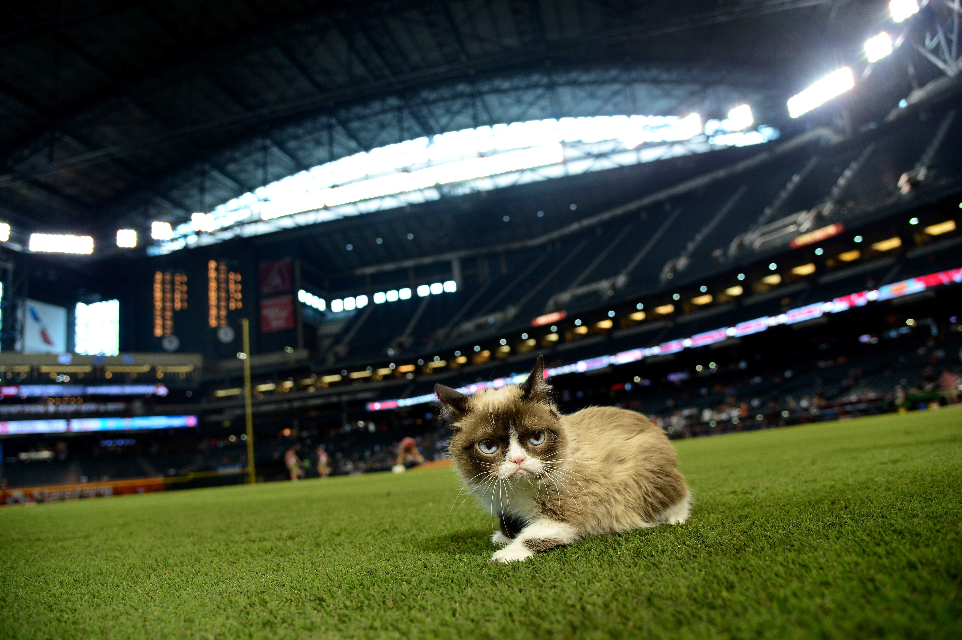
Do Sports Teams Make Cities Happier?
(Or Grumpier?)

Slide 2
Notes:
- 1950s
- Walter O’Malley
New stadium by Atlantic terminal
Wanted Eminent Domain Used but Robert Moses refused

Slide 3

Notes:
Half century later eminent domain was used to seize property to build the Barclays Center
Estimated 3000 people were forced out of their homes
What’s more, Cities spend a lot of money to get and keep sports teams in their cities.

Slide 4
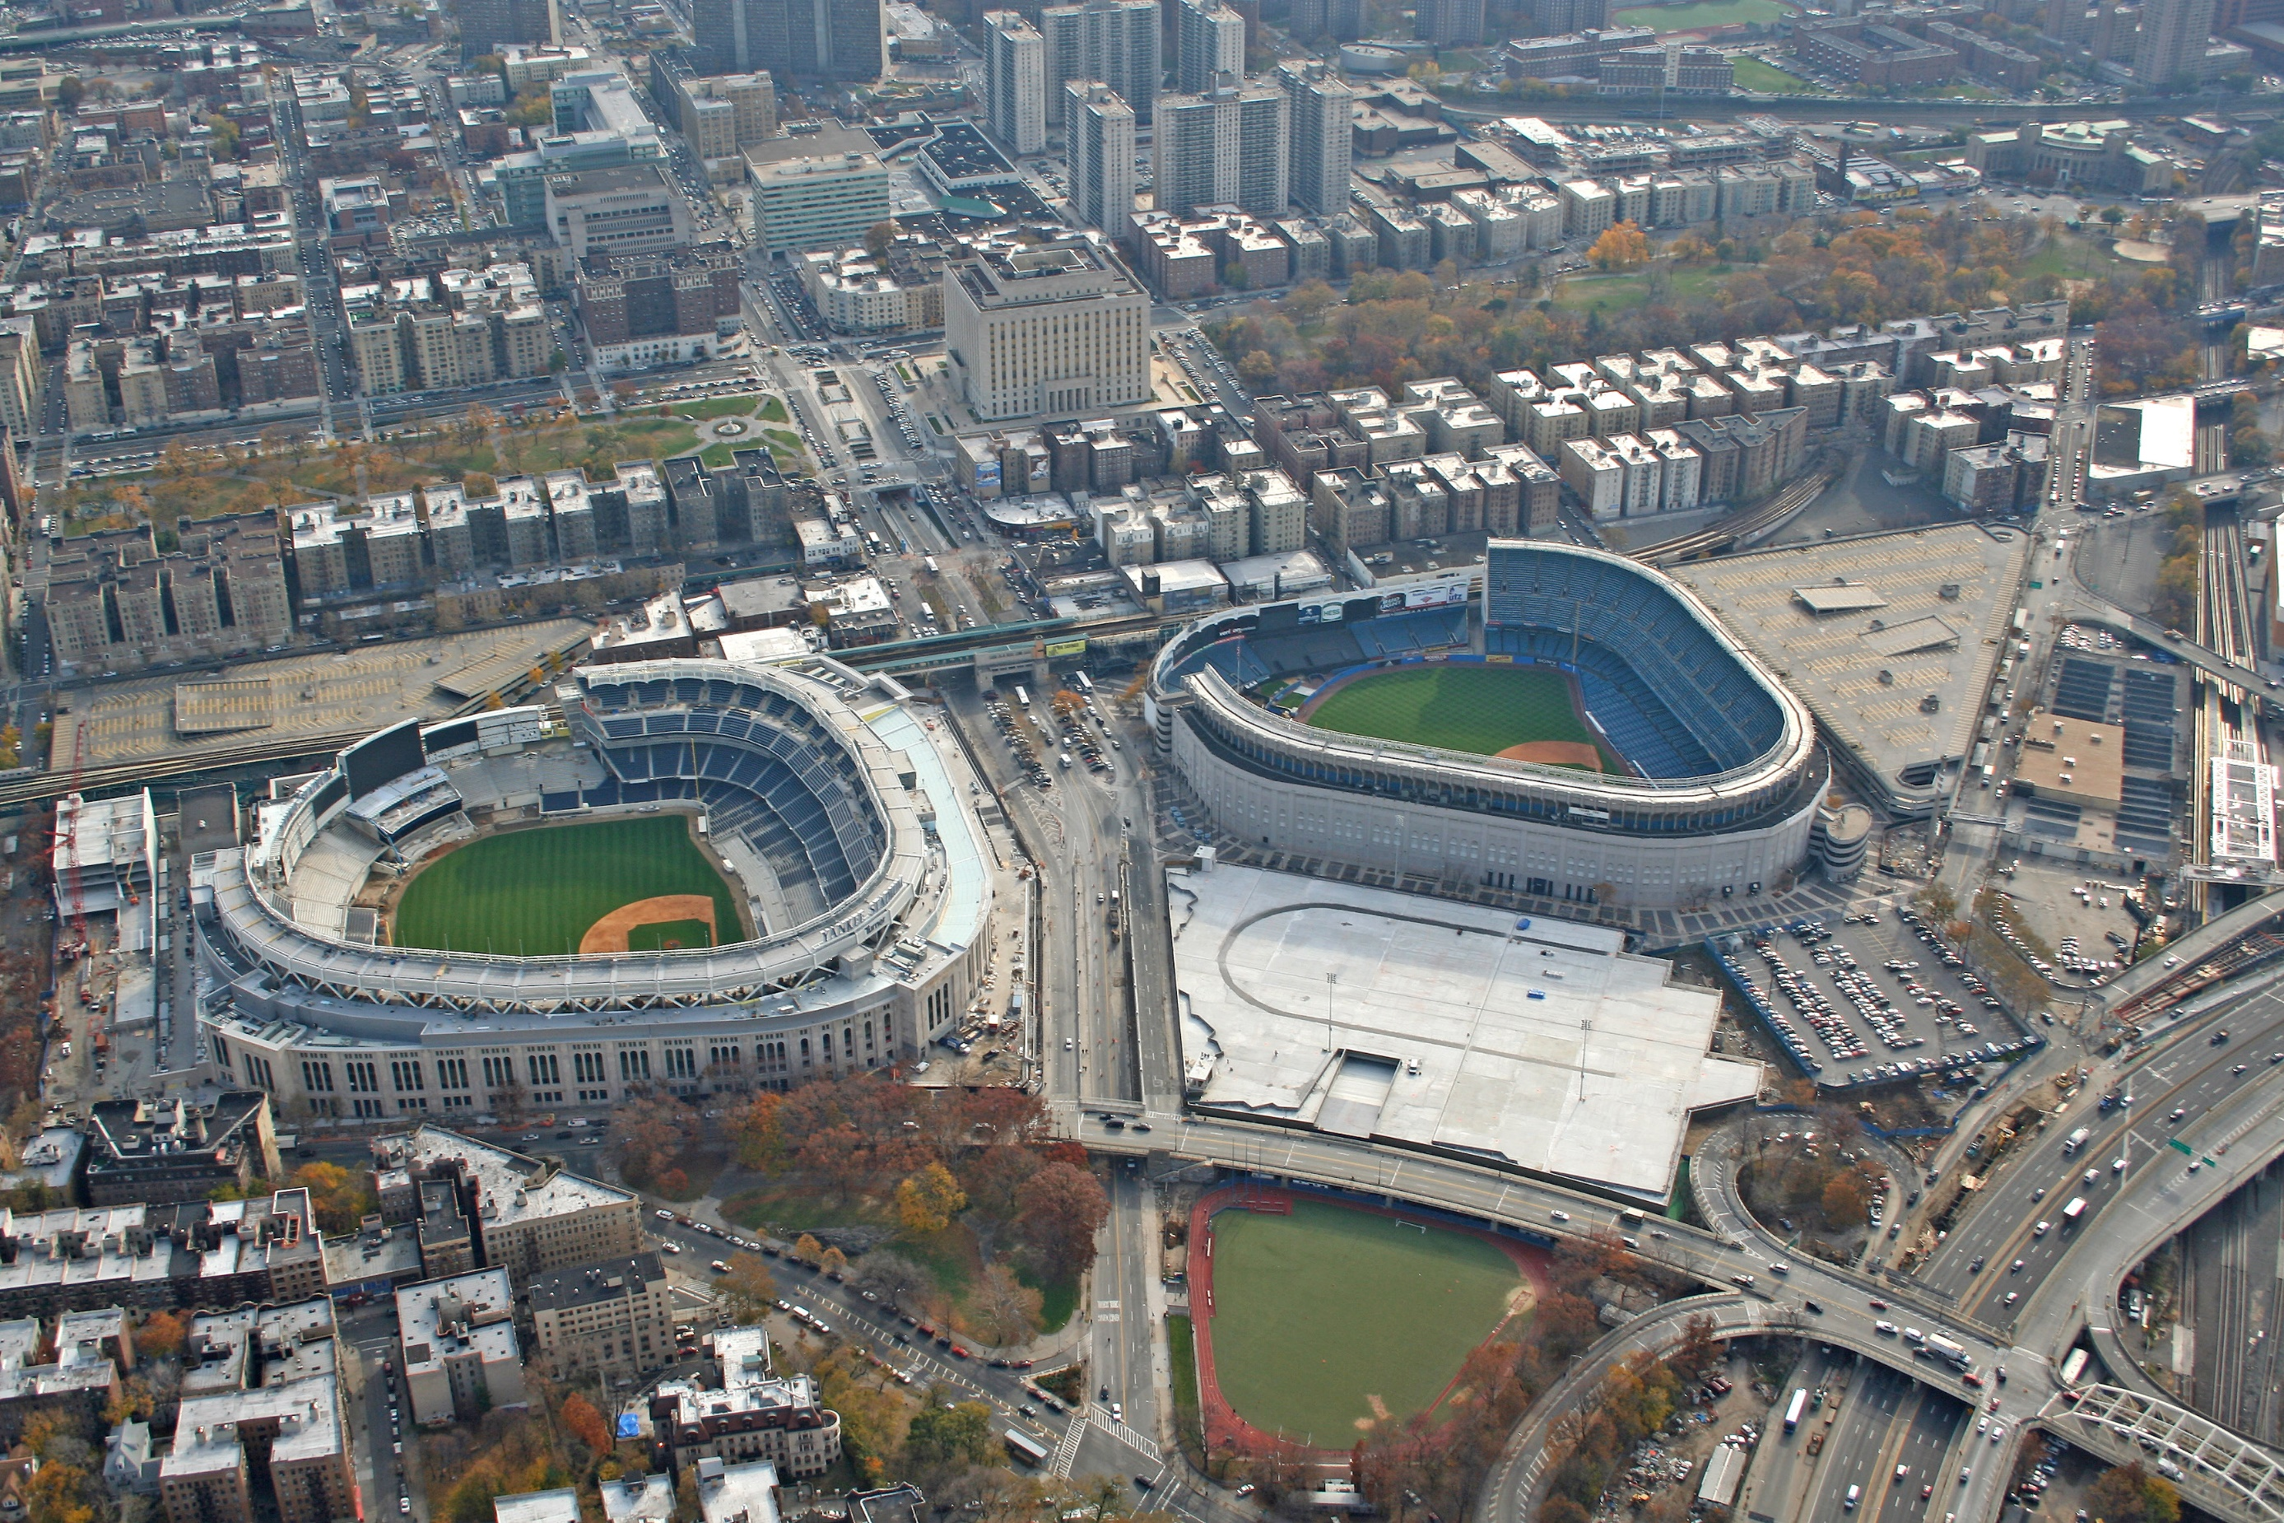
Notes:
Almost 2 Billion dollars in subsidies was given to the Mets and Yankees for them to build new stadiums several years ago
Can you tell the difference?
Why? What’s to gain.
It’s not economic.
Maybe it makes us happy?

Slide 5
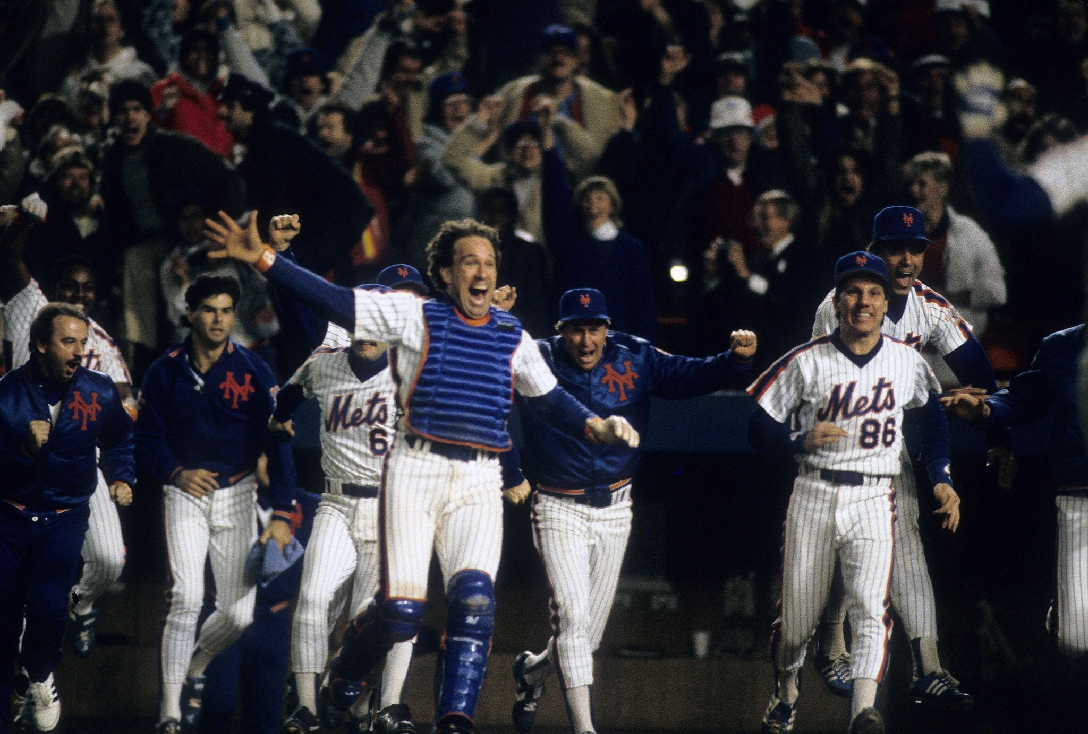
Notes:
Of course, happiness is very hard to quantify.
I tried looking at it from three different angles.

Slide 6
Notes:
NYC 311 (Do people complain less if they are in a good mood)
Boston Crime Records (Do people commit less crime?)
Twitter Data (Does sentiment seem happier?)

Slide 7
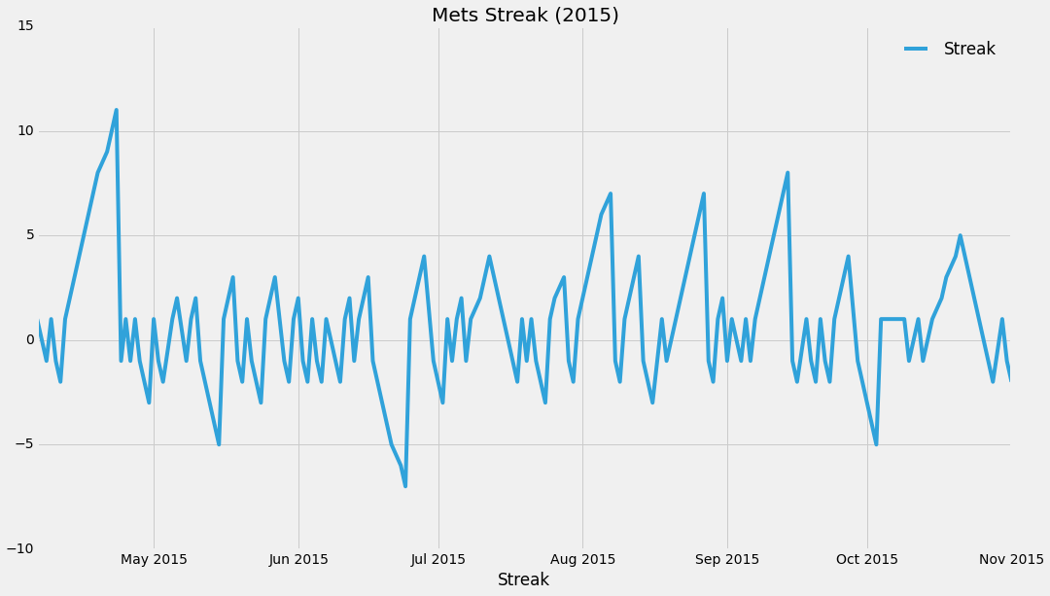
Notes:
- Analysis was very similar for all three so I won’t go through each one.
Quantified how a team was doing based on their current win streak and whether they were in the playoffs.

Slide 8
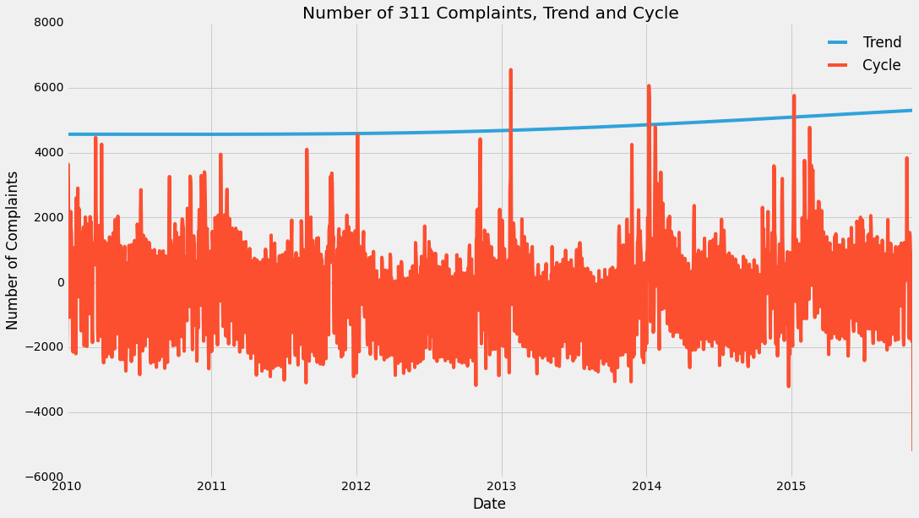
Notes:
Detrended the 311 Data to remove the overall upward trend.
Controlled for Weekends and time of year.

Slide 9
Mets Streak: 0.920 – 33.271
Yankees Streak: -22.737 – 11.996
Mets in Playoffs: -471 – 614
Yankees in Playoffs: -649 – 292
Notes:
Pretty much no results
The Coefficent for the Mets streak IS nonzero at a 5% confidence level, but it’s also negligible, and in the opposite direction
If anything, New Yorkers are grumpier when the Mets are winning.

Slide 10
Red Sox Streak: -1.149 – 0.607
Red Sox in Playoffs: -26 – 21
Notes:
Same result for Crime in Boston vs. the Red Sox.

Slide 11
This slide was unintentionally left blank.
Notes:
I had a very small set of twitter data consisting of about two weeks spread throughout the winter 2014-2015.
Classified the tweets from 0 (negative) to 1 (positive) using a classifier trained on movie reviews.
Calculated an average sentiment for the day.
Then did the same analysis as crime or 311.

Slide 12
Knicks Streak: -.003 – .008
Nets Streak: -.006 – .002
Notes:
Same story here

Slide 13
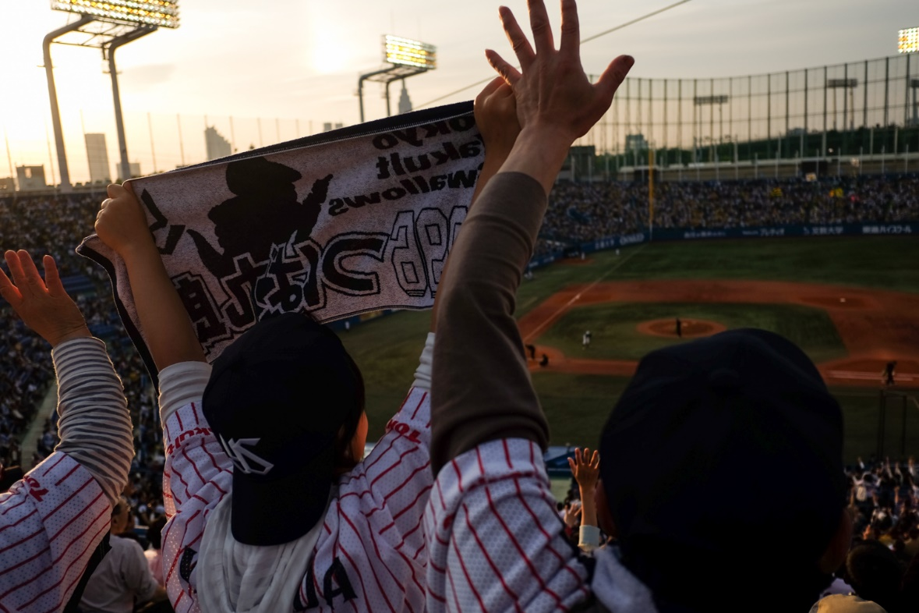
Notes:
Found no effect
Only based on performance, not binary exists, doesn’t exit
Might not be good measures of happiness
Further twitter analysis would be useful

